Slide 1
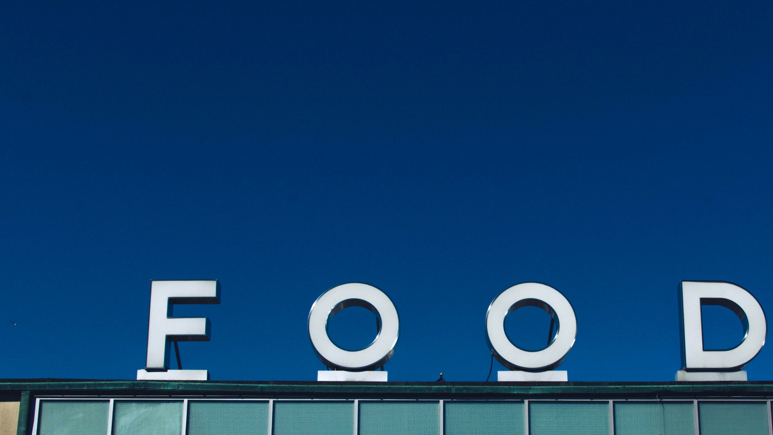
Lightning Talk
By Agustin Lastra
Problem:
Certain food ordering habits will lead to healthy or unhealthy lifestyles.
Having enough product inventory stock.
Driving Sales.
Hypothesis:
Users with healthier lifestyle and habits order during certain days of the week.
Larger orders of products are ordered during certain times of the week.
Certain products will lead to frequent re-ordering, driving sales.
Data Set:
3,421,083 Orders from Users from Instacart
206,209 Users
49,688 Products
134 Aisles
21 Departments
Original Source: https://tech.instacart.com/3-million-instacart-orders-open-sourced-d40d29ead6f2

